Slide 1

Paper Realization
Name：Gonghao Zhang

Slide 2
Code Related
Code Paper
Adrian Lang, Yi Wang*, Cheng Feng, Eleni Stai, and Gabriela Hug, “Data Aggregation Point Placements for Smart Meters in the Smart Grid,” IEEE Transactions on Smart Grid, in press.
Code Environment
MacBook Pro (Retina, 15-inch, Mid 2015) with an Intel Core i7 Quad Core @ 2.2 GHz and 16 GB 1600 MHz DDR3
Anaconda3, Python 3.9.9
Dependencies: networkx, scipy, sklearn, matplotlib, pyqt5, sklearn_extra, gurobipy
Code Sharing
Github: I opened my code to https://github.com/hewittzgh/SmartGrid
Configuration: $ conda env create -f environment.yml
Note: Linear Programming is implemented using Gurobi, which requires academic license

Slide 3

Result Presentation
Video in Appendix

Slide 4
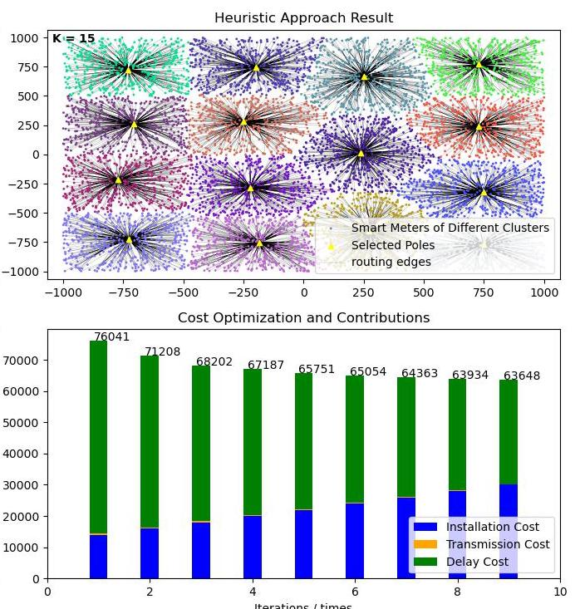
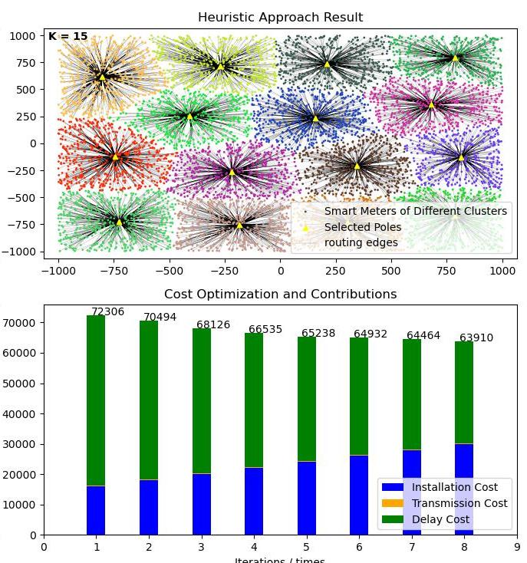
Reproduction details: Influence of different Clustering algorithms on N_MAX_SS=10, D_MAX=150, c=5
KMeans euclidean
MiniBatch-KMeans euclidean

Slide 5
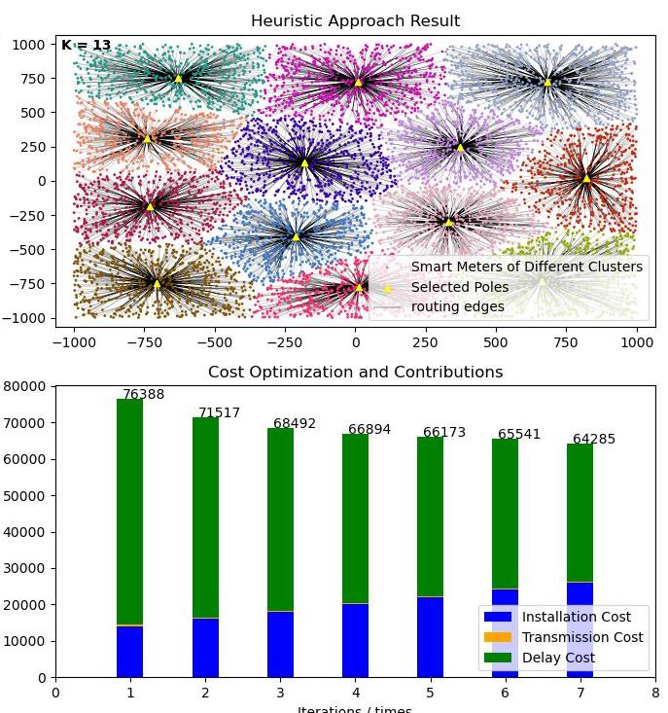
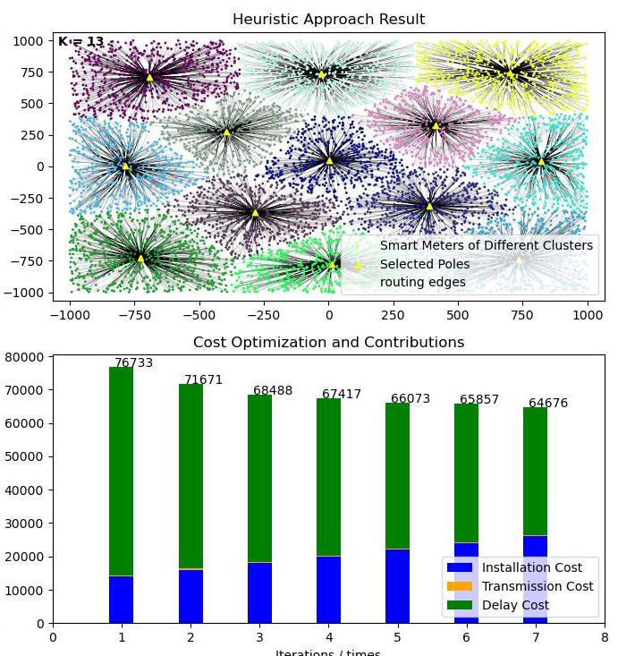
Reproduction details: Influence of different Clustering algorithms on N_MAX_SS=10, D_MAX=150, c=5
kmedoids euclidean
kmedoids energy

Slide 6
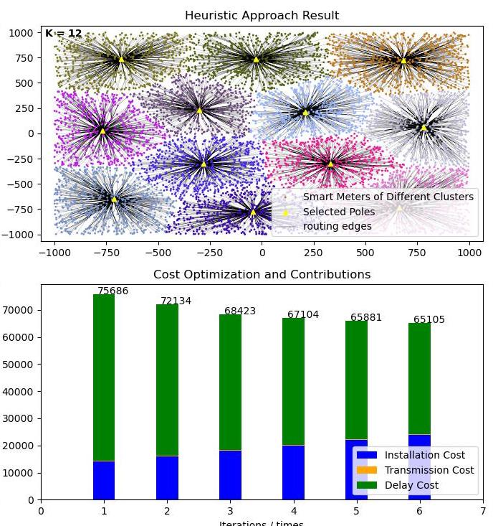
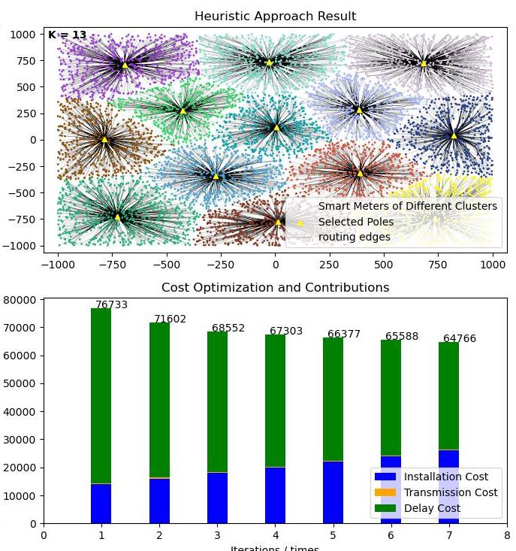
Reproduction details: Influence of different Clustering algorithms on N_MAX_SS=10, D_MAX=150, c=5
kmedoids cutoff
kmedoids cutoff-energy

Slide 7
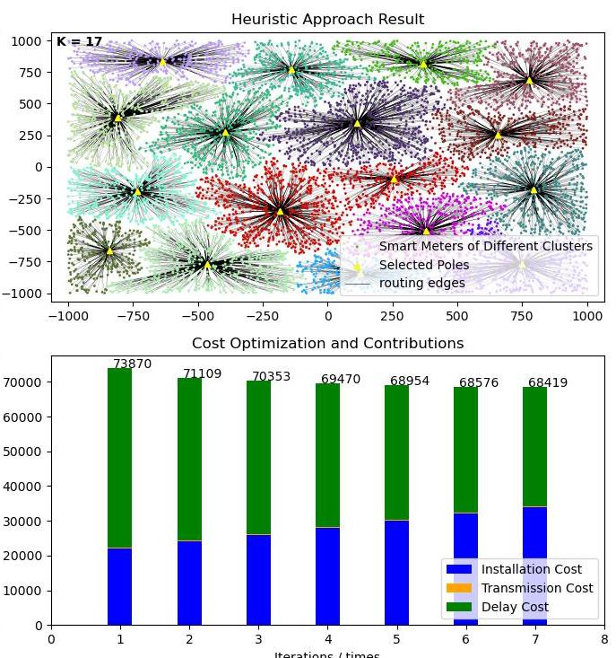
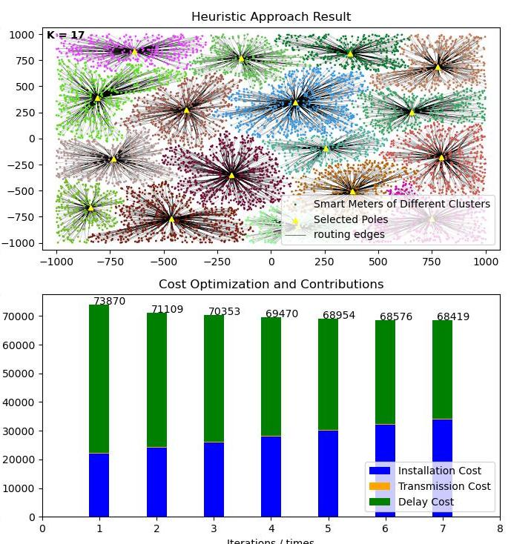
Reproduction details: Influence of different Clustering algorithms on N_MAX_SS=10, D_MAX=150, c=5
agglomerative euclidean
agglomerative energy

Slide 8
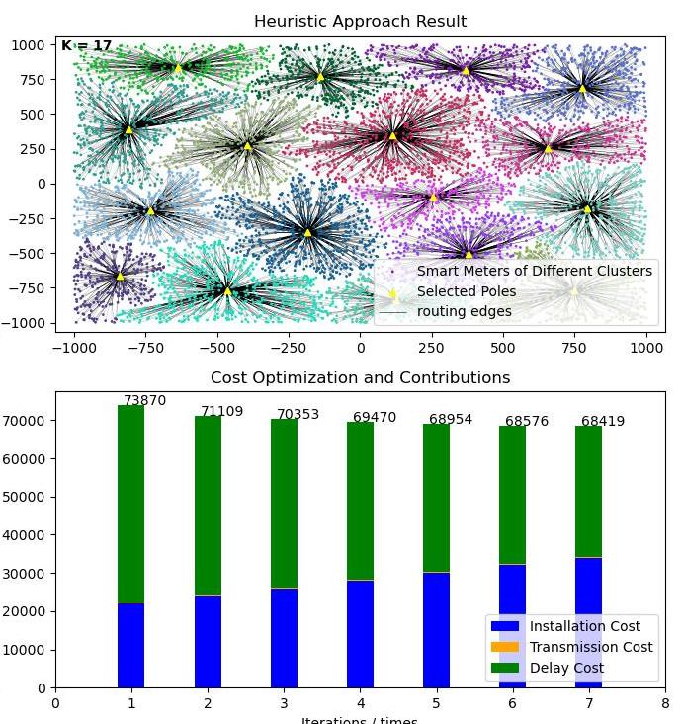
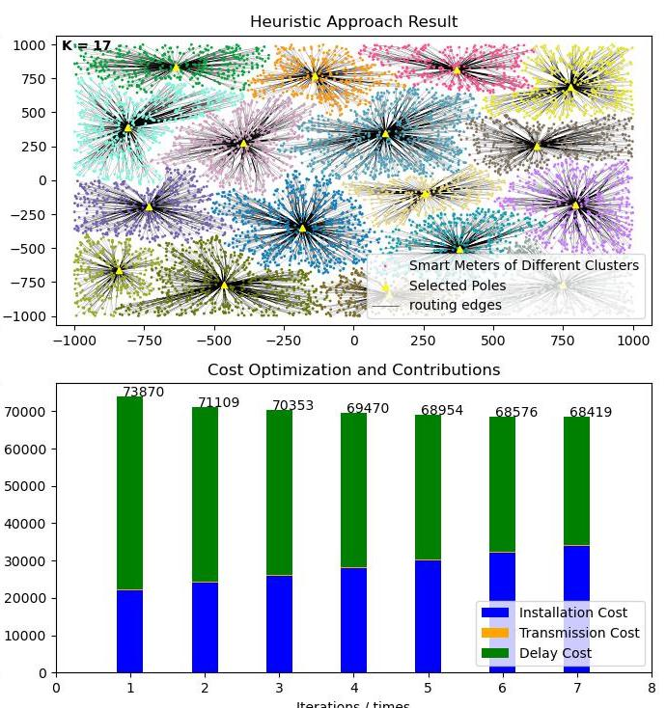
Reproduction details: Influence of different Clustering algorithms on N_MAX_SS=10, D_MAX=150, c=5
agglomerative cutoff
agglomerative cutoff-energy

Slide 9
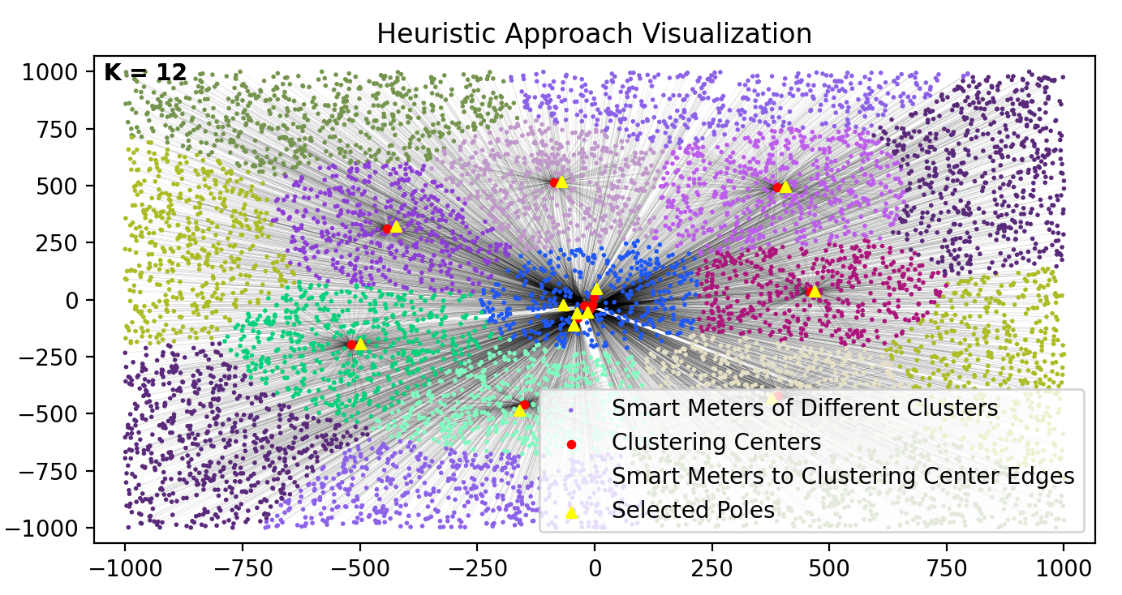
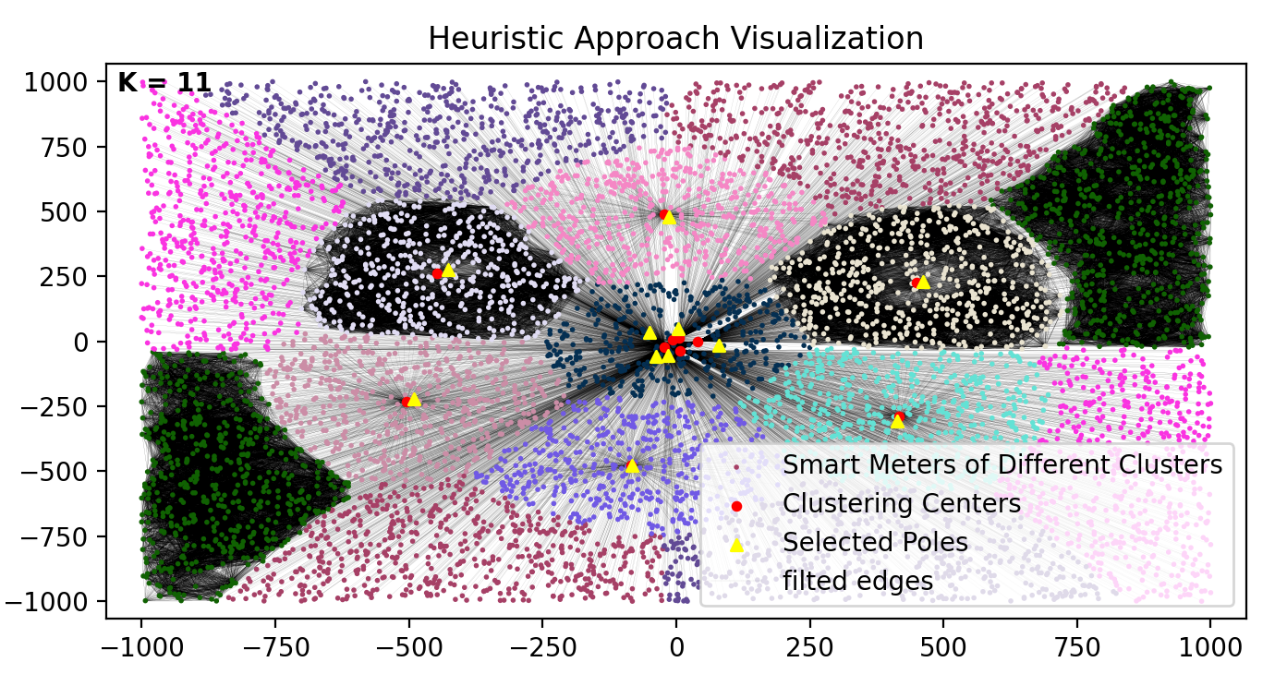
Reproduction details: Influence of different Clustering algorithms on N_MAX_SS=10, D_MAX=150, c=5
In my code, the Heuristic algorithm based on spectral clustering is difficult to converge, which may be due to the randomness of data, the effectiveness of the algorithm, the particularity of parameters and so on. As shown below.

Slide 10
Reproduction details: Influence of different Clustering algorithms on N_MAX_SS=10, D_MAX=150, c=5
 | KMeans | MiniBatch-KMeans | KMedoids |  |  |  | Agglomerative
 | eu | eu | eu | en | ct | cte | eu | en |  |  | ct |  | cte
No. of Clusters | 15 | 15 | 13 | 13 | 12 | 13 | 17 | 17 |  |  | 17 |  | 17
C-Installation | 30000 | 30000 | 26000 | 26000 | 24000 | 26000 | 34000 |  | 34000 | 34000 |  | 34000
C-Transmission | 228 | 230 | 255 | 256 | 265 | 256 | 229 |  | 229 | 229 |  | 229
C-Delay | 33420 | 33680 | 38030 | 38420 | 40840 | 38510 | 34190 |  | 34190 | 34190 |  | 34190
C-Total | 63648 | 63910 | 64285 | 64676 | 65105 | 64766 | 68419 |  | 68419 | 68419 |  | 68419

Slide 11
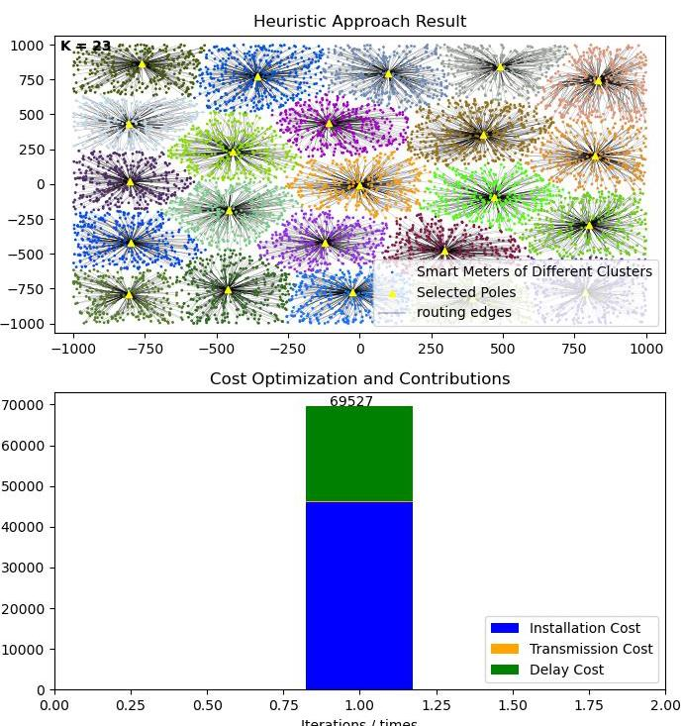
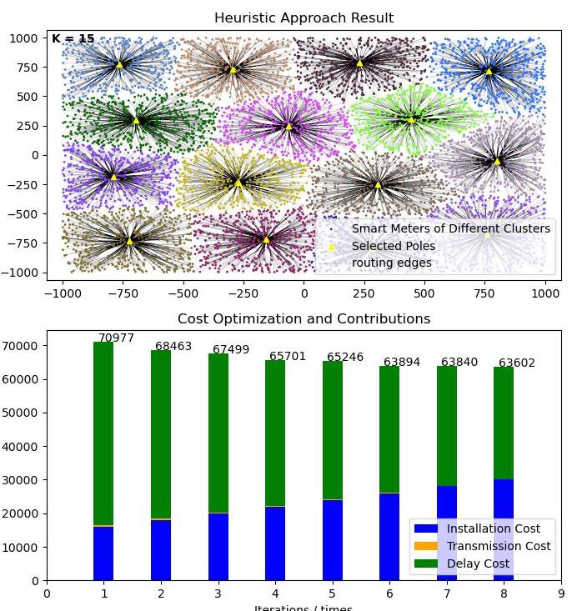
Reproduction details: Influence of different parameters on the D_MAX=150, c=5, alpha=3
N_MAX_SS = 3
N_MAX_SS = 10

Slide 12
Reproduction details: Influence of different parameters on the D_MAX=150, c=5, alpha=3
Cost | N_MAX_SS = 3 | N_MAX_SS = 10 | Relative change
C-Installation | 46000 | 30000 | - 34.8%
C-Transmission | 172 | 227 | +31.9%
C-Delay | 23355 | 33375 | +42.9%
C-Total | 69527 | 63602 | - 8.6%

Slide 13
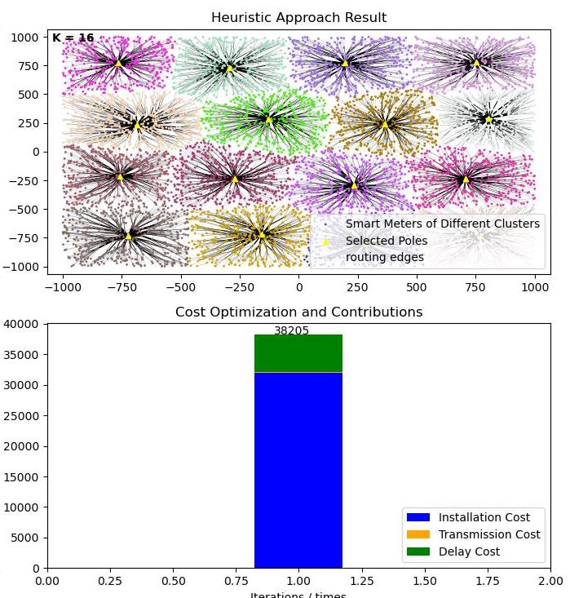
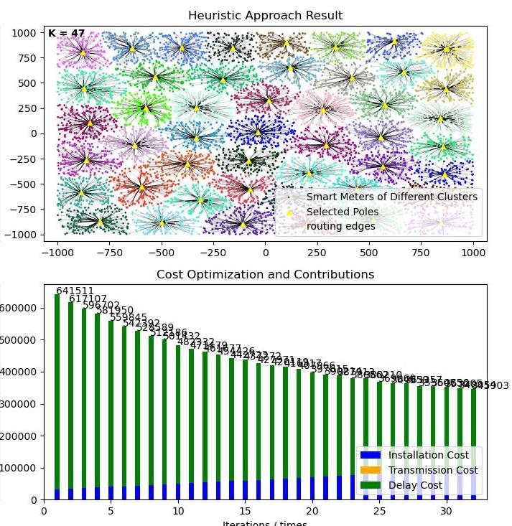
Reproduction details: Influence of different parameters on the N_MAX_SS=10, D_MAX=100, alpha=3
c = 0.5
c = 50

Slide 14
Reproduction details: Influence of different parameters on the N_MAX_SS=10, D_MAX=100, alpha=3
c | No. of Clusters | C-Installation | C-Transmission | C-Delay | C-Total
0.5 | 16 | 32000 | 111 | 6094 | 38205
5 | 18 | 36000 | 102 | 56060 | 92162
50 | 47 | 94000 | 53 | 251850 | 345903

Slide 15
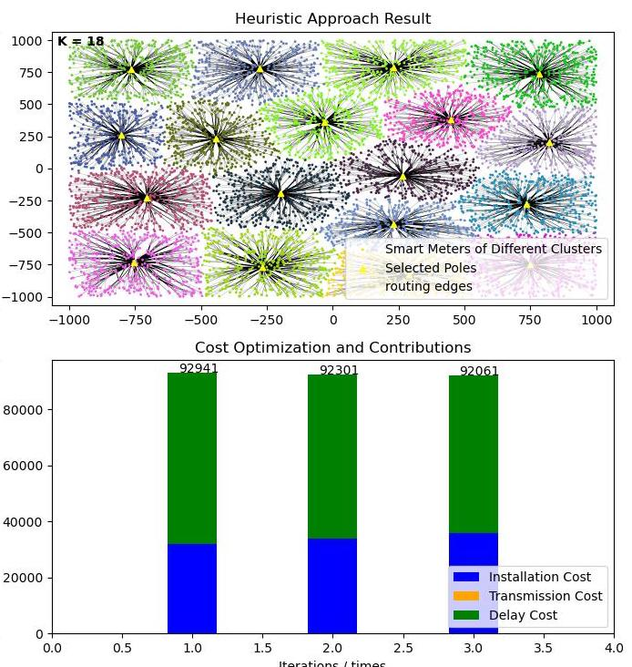
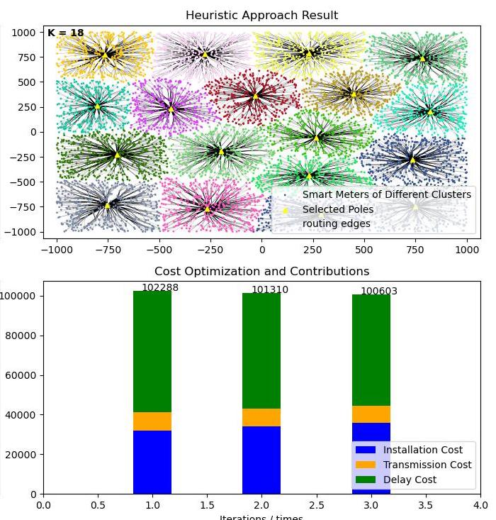
Reproduction details: Influence of different parameters on the N_MAX_SS=10, D_MAX=100, c=5
alpha = 2
alpha = 4

Slide 16
Reproduction details: Influence of different parameters on the N_MAX_SS=10, D_MAX=100, c=5
alpha | No. of Clusters | C-Installation | C-Transmission | C-Delay | C-Total
2 | 18 | 36000 | 1 | 56060 | 92061
3 | 18 | 36000 | 102 | 56060 | 92162
4 | 18 | 36000 | 8543 | 56060 | 100603

Slide 17
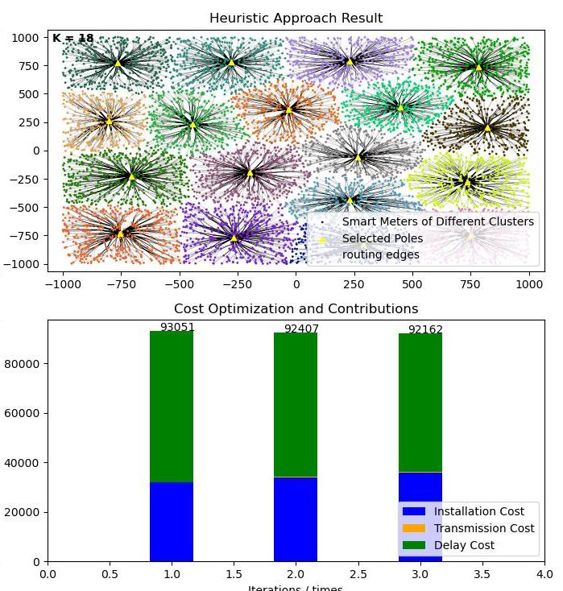
Reproduction details: Influence of different parameters on the N_MAX_SS=10, c=5, alpha=3
D_MAX = 100
D_MAX = 150

Slide 18
Reproduction details: Influence of different parameters on the N_MAX_SS=10, c=5, alpha=3
D_MAX | No. of Clusters | C-Installation | C-Transmission | C-Delay | C-Total
100 | 18 | 30000 | 227 | 33375 | 63602
150 | 15 | 36000 | 102 | 56060 | 92162

Slide 19
Reproduction details: Influence of different parameters on the N_MAX_SS=10, D_MAX=100, c=5
D_MAX | No. of Clusters | C-Installation | C-Transmission | C-Delay | C-Total
100 | 18 | 30000 | 227 | 33375 | 63602
150 | 15 | 36000 | 102 | 56060 | 92162
Thank you for your review
Name：Gonghao Zhang

